Slide 1
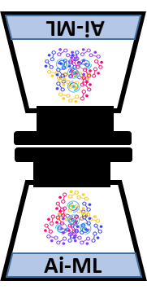
Recommendation system
Introduction
Debottleneck
Recommender systems are essential tools for filtering online information or products when there are too many choices.
Advantages:
Filtering large information (Dynamic information),
Address the need of personalized recommendation
Bottleneck
Cold Start Problem (new users/items lack data),
Shilling Attack Problem (malicious users manipulate ratings),
Synonymy Problem (different names for similar items),
Latency Problem (delays due to needed reviews),
Sparsity Problem (insufficient ratings),
Scalability Problem (handling large data).
Content-Based Recommender Systems: Use item features to recommend similar items to those the user has liked.
Collaborative Filtering-Based Recommender Systems: predict user preference by collecting preferences from other users
Types: User-based and item based
Hybrid Recommender Systems: Combine multiple techniques to overcome the limitations of individual methods.
Meta-level, feature hybridization
Nilesh Kumar

